Slide 1
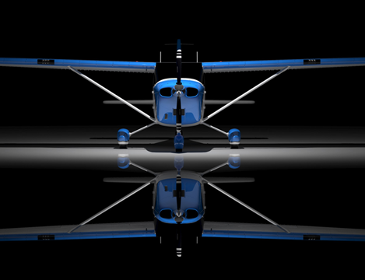
VICTORIA FLYING CLUB
SYSTEMS & INSTRUMENTS

Slide 2
SYSTEMS & INSTRUMENTS
CONTENTS
ELECTRICAL SYSTEM
FUEL SYSTEM
PITOT STATIC SYSTEM AND INSTRUMENTS
VACUUM SYSTEM AND GYROSCOPIC INSTRUMENTS
MAGNETIC COMPASS
INSTRUMENT SCAN

Slide 3
ELECTRICAL SYSTEM
OVERVIEW
AN AIRCRAFT ELECTRICAL SYSTEM SUPPLIES POWER TO START THE ENGINE AND OPERATE A MULTITUDE OF ITEMS.
FLAPS, LANDING GEAR, AVIONICS, LIGHTS, FANS, DE-ICE & ANTI-ICE EQUIPMENT, WINDSHIELD WIPERS, ETC.

Slide 4
ELECTRICAL SYSTEM
OVERVIEW
AN AIRCRAFT ELECTRICAL SYSTEM CONSISTS OF:
A BATTERY TO POWER THE ELECTRICAL SYSTEM WHEN THE ENGINE IS NOT RUNNING.
A GENERATOR OR ALTERNATOR TO POWER THE ELECTRICAL SYSTEM WHEN THE SYSTEM IS RUNNING, AND TO RECHARGE THE BATTERY.

Slide 5
ELECTRICAL SYSTEM
VOLTAGE
IS THE “PRESSURE” THAT MAKES AN ELECTRIC CHARGE MOVE – MEASURED IN VOLTS.
CURRENT
THE “FLOW” OF ELECTRIC CHARGE THROUGH A CONDUCTOR – MEASURED IN AMPERES (AMPS).
RESISTANCE
THE RESISTANCE TO “FLOW” BASED ON THE CONDUCTORS COMPOSITION AND SIZE.

Slide 6
ELECTRICAL SYSTEM
BATTERY
A DEVICE USED AS A SOURCE OF POWER CONSISTING OF ONE OR MORE CELLS IN WHICH CHEMICAL ENERGY IS CONVERTED INTO ELECTRICAL ENERGY.
CLASSIFIED INTO TWO CATAGORIES:
PRIMARY AND SECONDARY.

Slide 7
ELECTRICAL SYSTEM
BATTERY
PRIMARY CELLS CANNOT BE RECHARGED – ZINC CARBON & ALKALINE.
SECONDARY CELLS CAN BE RECHARGED – LEAD ACID, NICKEL CADMIUM (NICD), NICKEL METAL-HYDRIDE, LITHIUM.

Slide 8
ELECTRICAL SYSTEM
BATTERY
PRIMARY CELLS ARE NOT USED TO POWER AIRCRAFT SYSTEMS.
SECONDARY CELLS TYPICALLY USED TO POWER AIRCRAFT SYSTEMS ARE OF THE LEAD ACID OR NICKEL CADMIUM VARIETY.

Slide 9
ELECTRICAL SYSTEM
BATTERY
THEY ARE RATED BY VOLTAGE AND AMP / HOUR.
AMP / HOUR IS THE CAPACITY TO CRANK THE ENGINE, OR RUN THE ELECTRACAL SYSTEM IN THE EVENT OF A GENERATOR / ALTERNATOR FAILURE.
A 20 AMP / HOUR BATTERY WILL SUPPLY 20 AMPS FOR ONE HOUR, OR 1 AMP FOR 20 HOURS.

Slide 10
ELECTRICAL SYSTEM
12 VOLT
A 12 VOLT BATTERY POWERS A 14 VOLT ALTERNATOR / GENERATOR ELECTRICAL SYSTEM.
LOWER COLD CRANKING AMPS (CCA) MAKE COLD WEATHER STARTING DIFFICULT.
LOWER COST / THICKER WIRE (LOWER GAUGE).
LIGHTER BATTERY / HEAVIER WIRING.

Slide 11
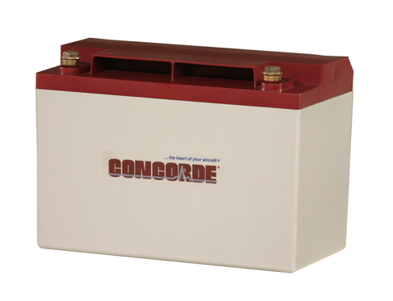
ELECTRICAL SYSTEM
12 VOLT BATTERY
23 LBS

Slide 12
ELECTRICAL SYSTEM
24 VOLT
A 24 VOLT BATTERY POWERS A 28 VOLT ALTERNATOR / GENERATOR ELECTRICAL SYSTEM.
HIGHER COLD CRANKING AMPS (CCA) MAKE COLD WEATHER STARTING EASIER.
HIGHER COST / THINNER WIRE (HIGHER GAUGE).
HEAVIER BATTERY / LIGHTER WIRING.
CESSNA TRANSITIONED TO 24 / 28 VOLT in 1977.

Slide 13
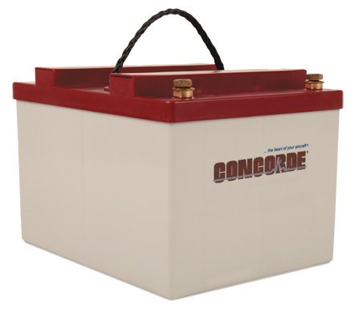
ELECTRICAL SYSTEM
24 VOLT BATTERY
30 LBS

Slide 14
ELECTRICAL SYSTEM
SOLENOID (RELAY)
A COIL OF WIRE WHICH BECOMES AN ELECTROMAGNET WHEN AN ELECTRICAL CURRENT PASSES THROUGH IT.
A SWITCH THAT CAN BE TURNED ON AND OFF.
SOLENOIDS ISOLATE ITEMS FROM THE REST OF THE ELECTRICAL SYSTEM.
CESSA 172: BATTERY, STARTER, ALTERNATOR, EXTERNAL POWER.

Slide 15
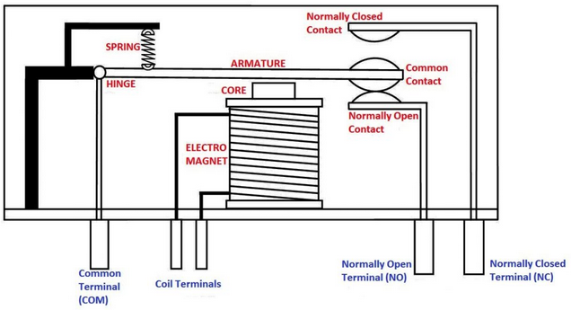

Slide 16
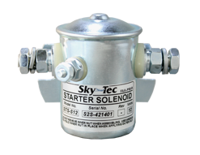
ELECTRICAL SYSTEM
SOLENOID

Slide 17
ELECTRICAL SYSTEM
STARTER MOTOR
A DEVICE USED FOR ROTATING AN INTERNAL COMBUSTION ENGINE IN ORDER TO INITIATE THE ENGINE’S OPERATION UNDER ITS OWN POWER.
STARTERS CAN BE ELECTRIC, PNEUMATIC, HYDRAULIC, OR SPRING LOADED.

Slide 18
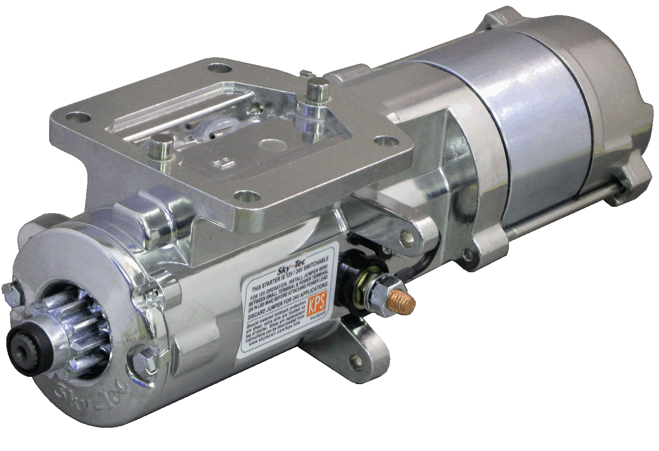
ELECTRICAL SYSTEM
ELECTRIC STARTER

Slide 19
ELECTRICAL SYSTEM
GENERATOR / ALTERNATOR
CONVERT MECHANICAL ENERGY INTO ELECTRICAL ENERGY.
MECHANICAL COMPONENTS:
ROTOR – THE ROTATING COMPONENT
STATOR – THE STATIONARY PART
ELECTRICAL COMPONENTS:
ARMATURE – THE POWER GENERATING COMPONENT
FIELD – THE MAGNETIC COMPONENT

Slide 20
ELECTRICAL SYSTEM
GENERATOR
UTILIZE A ROTATING ARMATURE (WINDINGS OF
FINE WIRE) INSIDE A FIXED MAGNETIC FIELD (STATOR).
THE MAJORITY OF CONSTRUCTION IS A MAGNET MAKING THEM HEAVY.

Slide 21
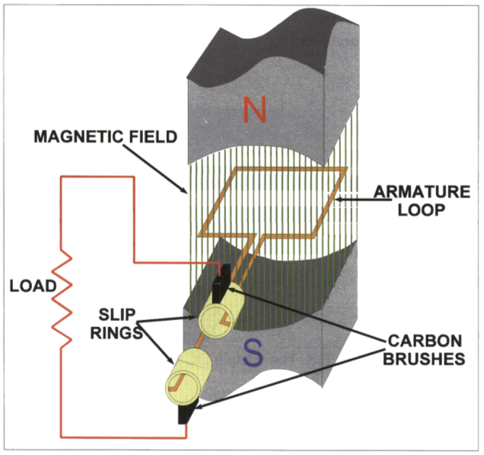
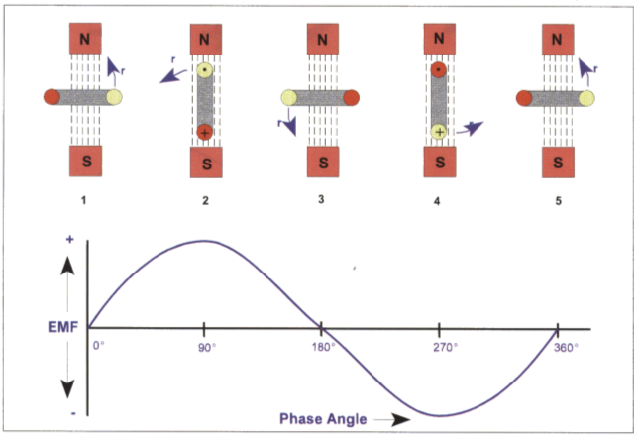

Slide 22
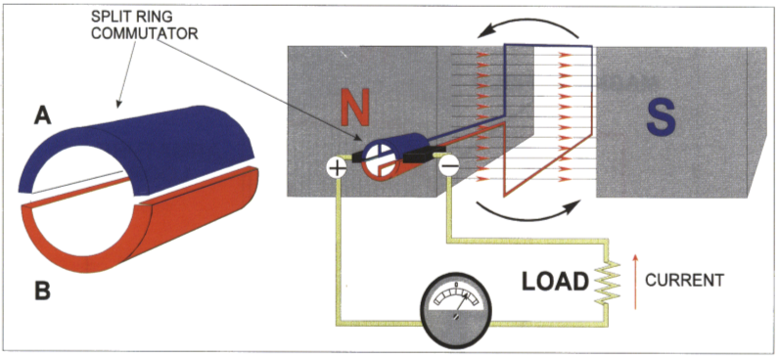
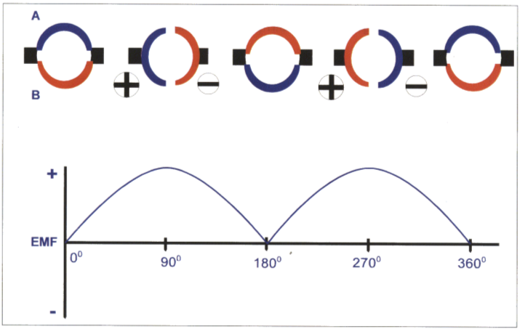

Slide 23
ELECTRICAL SYSTEM
GENERATOR
THEY DON’T PRODUCE RATED OUTPUT UNTIL ENGINE RPM IS UP IN THE MID RANGE OF OPERATION – APPROXIMATELY 1400 RPM.
DURING TAXIING AND LOW POWER OPERATIONS THE BATTERY PROVIDES THE MAIN SOURCE OF POWER.

Slide 24
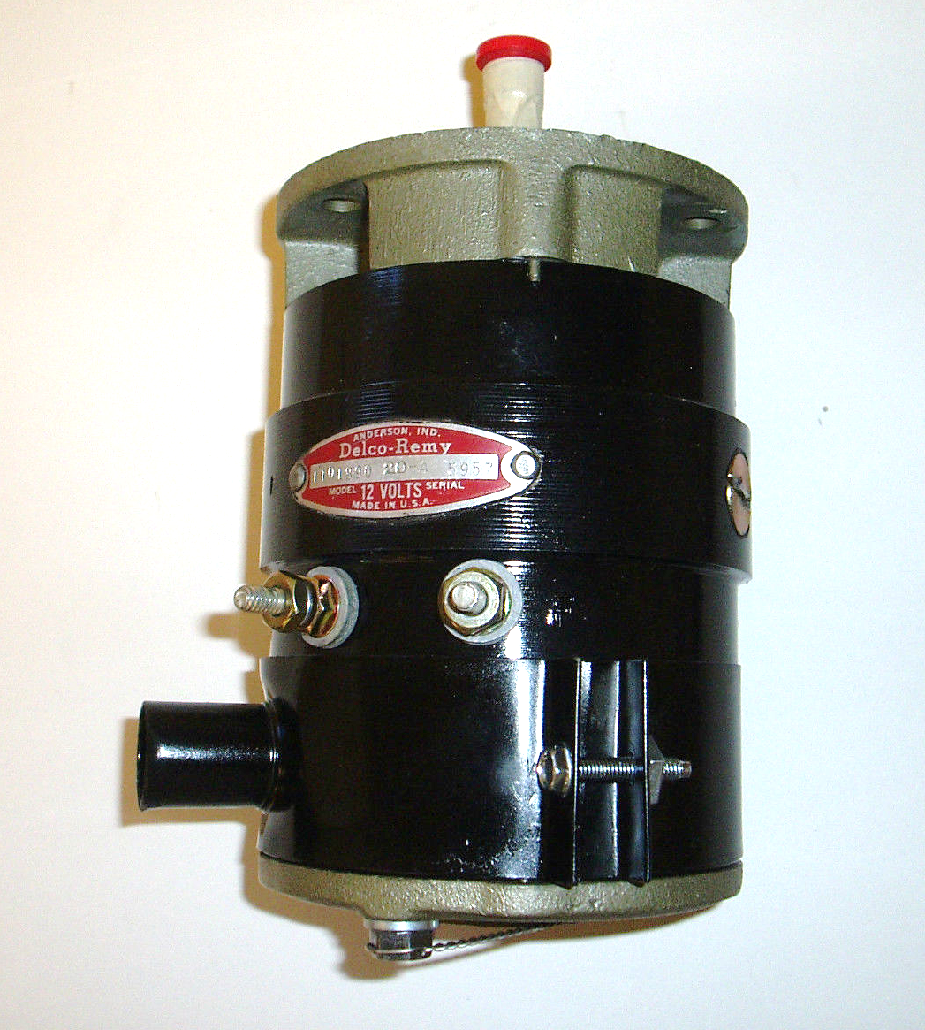
ELECTRICAL SYSTEM
GENERATOR

Slide 25
ELECTRICAL SYSTEM
ALTERNATOR
UTILIZE A ROTATING MAGNETIC FIELD (ROTOR) INSIDE AN ARMATURE (WINDINGS OF FINE WIRE).
THEY ARE LIGHT WEIGHT AND CAPABLE OF PRODUCING FULL RATED OUTPUT AT LOW ENGINE RPM.

Slide 26
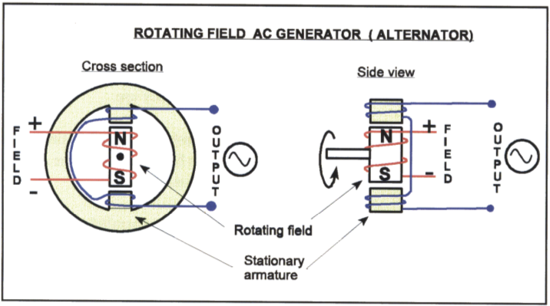

Slide 27
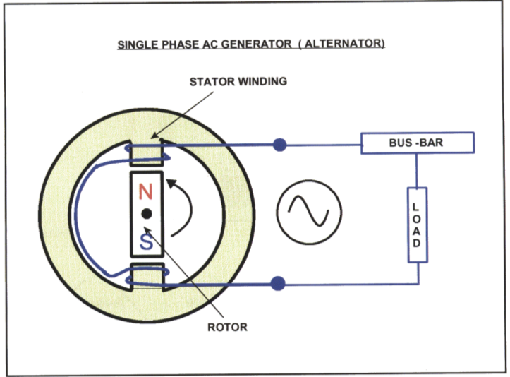
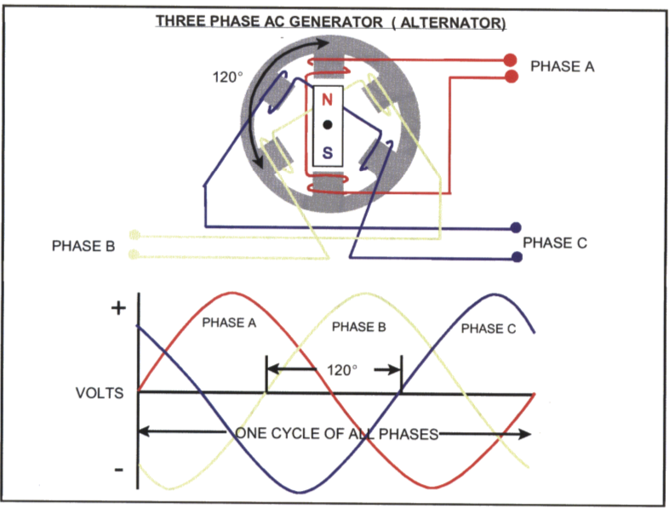

Slide 28
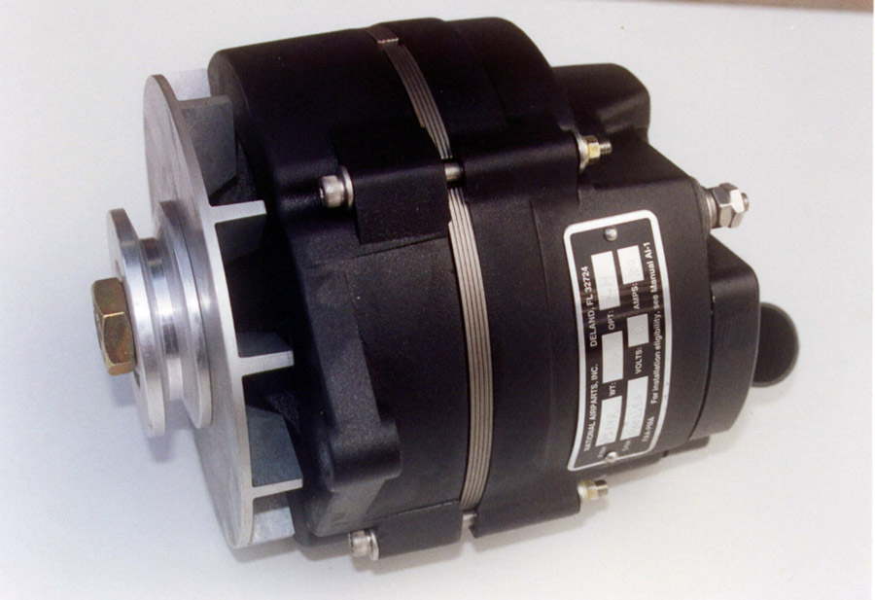
ELECTRICAL SYSTEM
ALTERNATOR

Slide 29
ELECTRICAL SYSTEM
VOLTAGE REGULATOR
A RESISTOR WHICH PREVENTS THE GENERATOR / ALTERNATOR FROM OVERLOADING THE ELECTRICAL SYSTEM.
PREVENTS THE BATTERY FROM BEING OVERCHARGED.

Slide 30

ELECTRICAL SYSTEM
VOLTAGE REGULATOR

Slide 31
ELECTRICAL SYSTEM
BUS BAR
A METALLIC STRIP OR BAR (COPPER, BRASS, ALUMINUM) WHICH CONDUCTS ELECTRICITY RECEIVED FROM THE BATTERY, ALTERNATOR / GENERATOR.
CURRENT PASSES THROUGH VARIOUS CIRCUIT BREAKERS / FUSES AND BRANCHES OUT TO VARIOUS ELECTRICAL COMPONENTS.

Slide 32
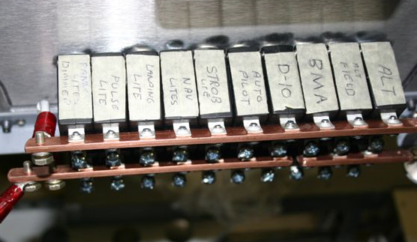
ELECTRICAL SYSTEM
BUS BAR

Slide 33
ELECTRICAL SYSTEM
CIRCUIT BREAKER / FUSE
AN AUTOMATIC ELECTRICAL SWITCH OR RESISTOR DESIGNED TO PROTECT AN ELECTRICAL CIRCUIT FROM DAMAGE CAUSED BY OVERLOAD OR SHORT CIRCUIT.
CIRCUIT BREAKERS “TRIP” AND FUSES “BLOW” WHEN THEIR RATED CURRENT IS EXCEEDED.

Slide 34
ELECTRICAL SYSTEM
CIRCUIT BREAKER / FUSE
CIRCUIT BREAKERS CAN BE RESET AND FUSES ARE A SINGLE USE SACRIFICIAL DEVICE.
CESSNA TRANSITIONED FROM FUSES TO CIRCUIT BREAKERS IN 1964.

Slide 35
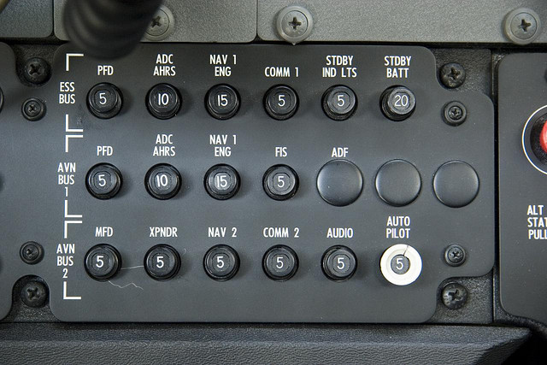
ELECTRICAL SYSTEM
CIRCUIT BREAKER PANEL

Slide 36

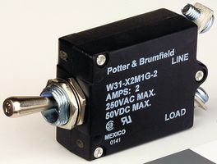
ELECTRICAL SYSTEM
CIRCUIT BREAKER
BREAKER SWITCH

Slide 37
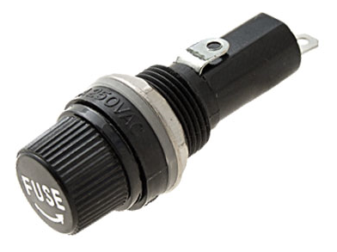
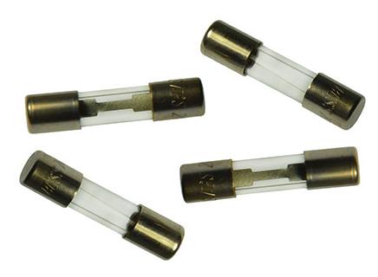
ELECTRICAL SYSTEM
FUSE RECEPTACLE
FUSES

Slide 38
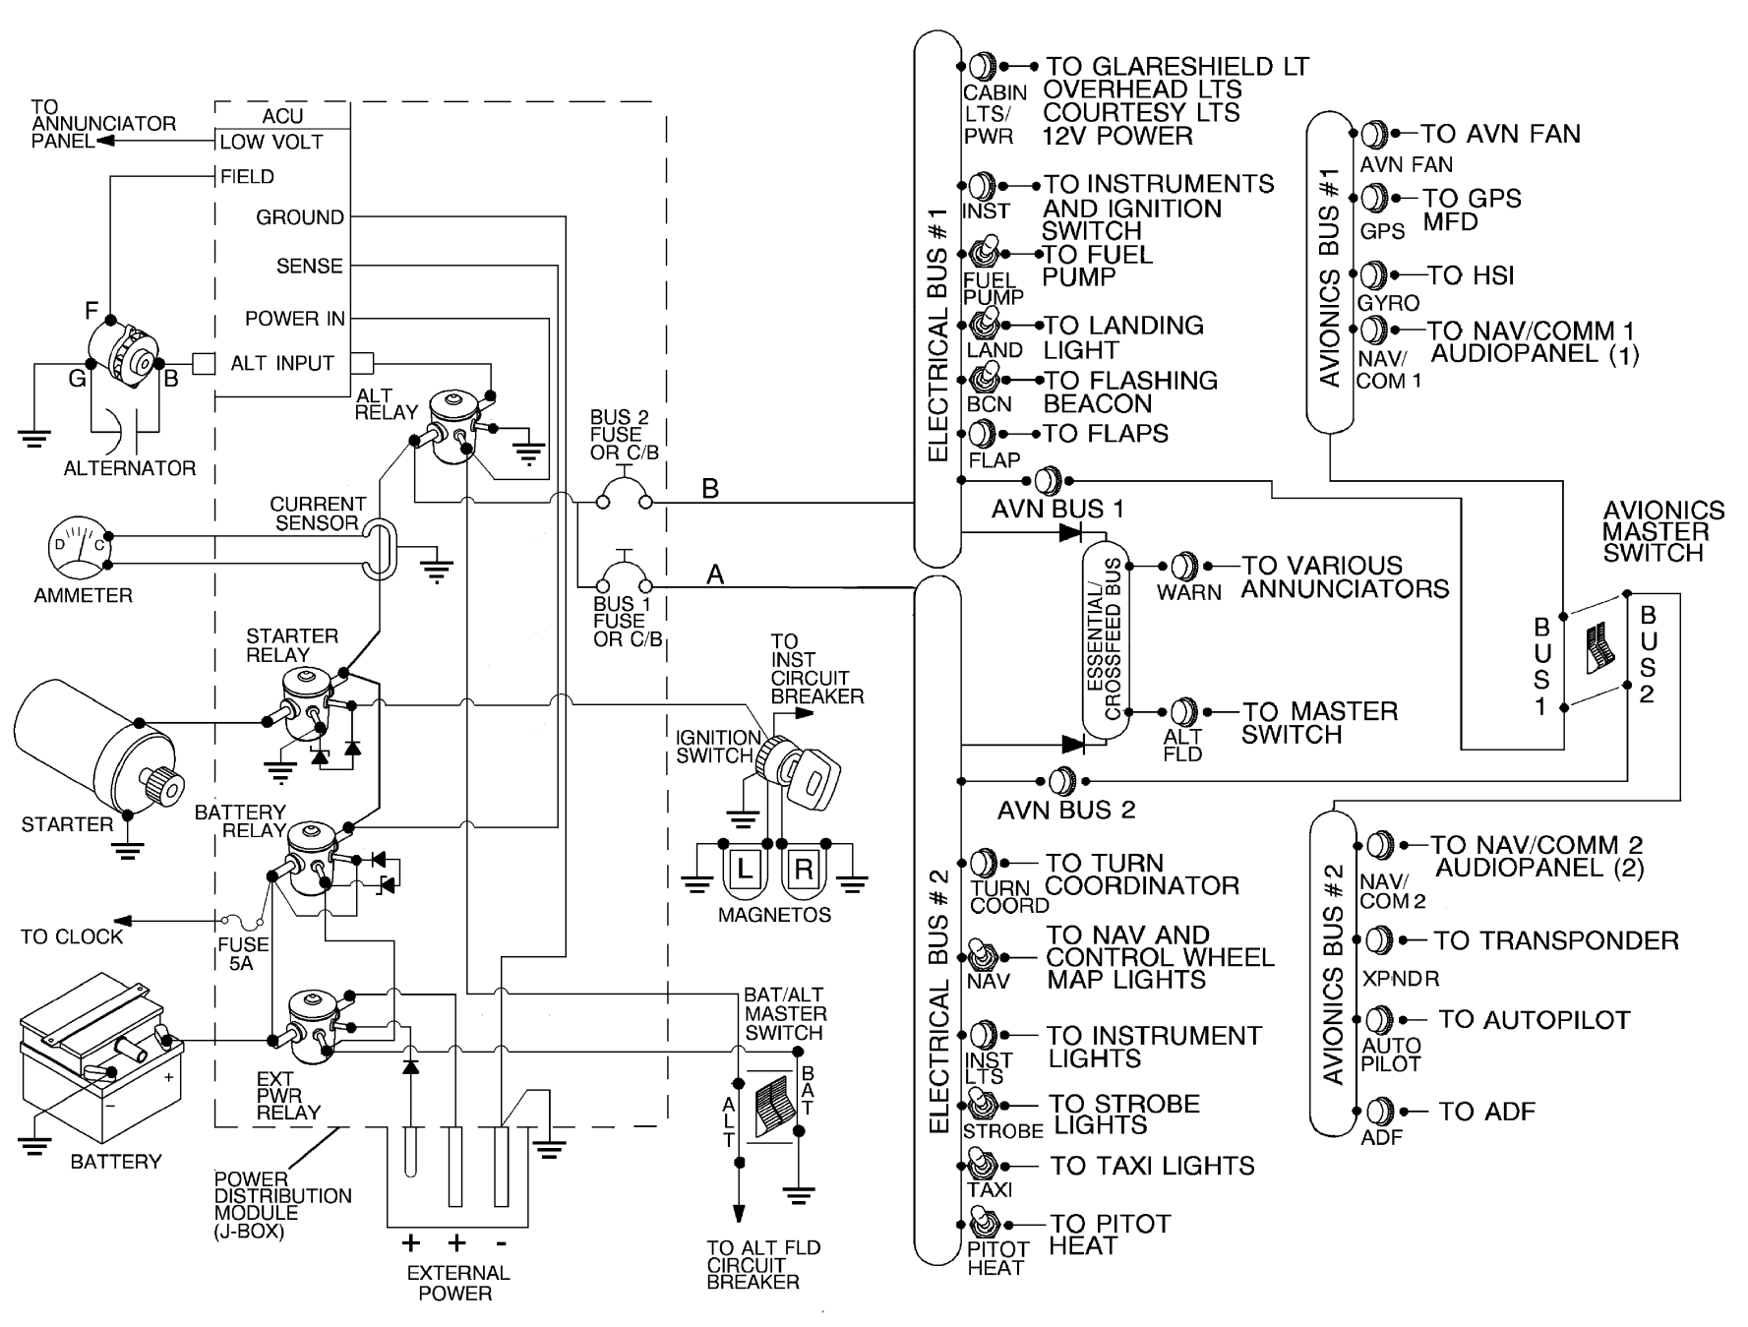
ELECTRICAL SYSTEM
CESSNA 172S
POH 7-30

Slide 39
ELECTRICAL SYSTEM
GROUNDING
DURING THE REFUELING PROCESS STATIC ELECTRICITY CAN BE BUILT UP WHEN FUEL IS TRANSFERRED FROM A FUEL TRUCK / TANK INTO AN AIRCRAFT.
WHEN THE CHARGE BECOMES HIGH ENOUGH A SPARK WILL OCCUR IGNITING THE FUEL VAPOUR.
A GROUNDING WIRE IS CONNECTED TO AN AIRCRAFT (TIE-DOWN RING OR EXHAUST STACK) DURING REFUELING TO PREVENT THIS HAZARD.

Slide 40
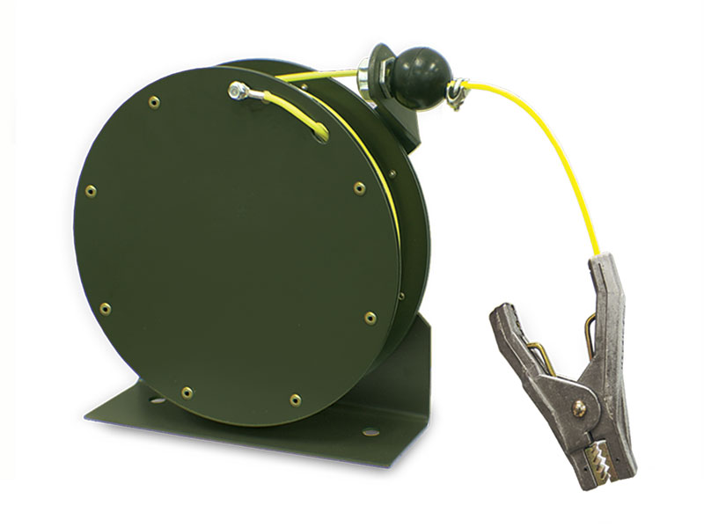
ELECTRICAL SYSTEM
GROUNDING WIRE

Slide 41
ELECTRICAL SYSTEM
BONDING
THE PROCESS OF CONNECTING METAL COMPONENTS THAT ARE NOT SUPPOSED TO CARRY CURRENT TO ALIGN THEM INTO THE SAME ELECTRICAL POTENTIAL.
PROVIDES LIGHTNING PROTECTION BY ALLOWING CURRENT TO PASS THROUGH THE AIRFRAME WITH MINIMUM ARCING.

Slide 42
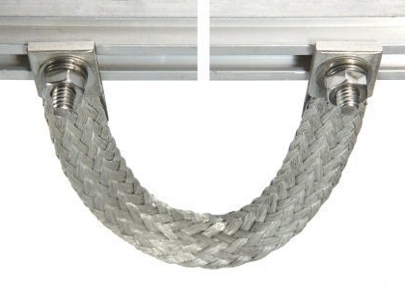
ELECTRICAL SYSTEM
BONDING WIRE

Slide 43
ELECTRICAL SYSTEM
STATIC WICKS
AIRCRAFT IN FLIGHT CAN BUILD UP STATIC ELECTRICITY BY FLYING THROUGH RAIN, SNOW, ICE, & DUST.
THIS BUILD-UP CAN INTERFERE WITH RADIO AND NAVIGATIONAL EQUIPMENT.
“WICKS” ARE ATTATCHED TO CONTROL SURFACES TO DISCHARGE THESE ELECTRONS BACK TO THE SURROUNDING AIR.

Slide 44
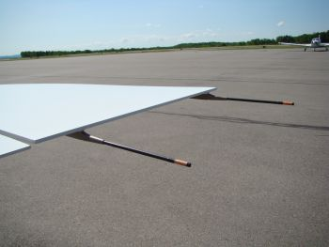
ELECTRICAL SYSTEM
STATIC WICKS

Slide 45
FUEL
AVGAS
AVIATION GASOLINE
MOGAS
AUTOMOTIVE GASOLINE

Slide 46
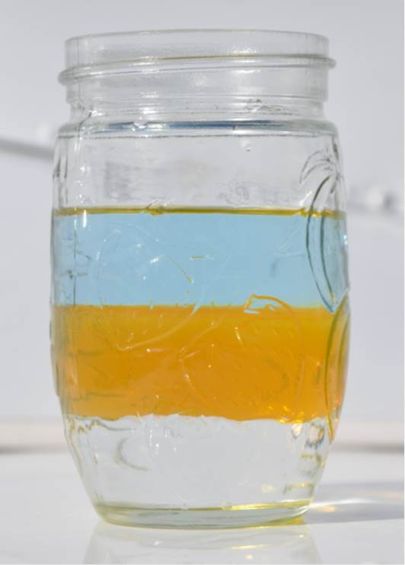
FUEL
AVGAS – 6 LBS PER GALLON
OIL – 8 LBS PER GALLON
WATER – 10 LBS PER GALLON

Slide 47
FUEL
OCTANE
THE MEASUREMENT OF THE PERFORMANCE OF FUEL.
HIGH OCTANE FUEL CAN WITHSTAND A HIGHER LEVEL OF COMPRESSION BEFORE DETONATING (IGNITING) THAN A LOW OCTANE FUEL.
HIGH OCTANE FUEL IS USED IN HIGHER PERFORMANCE ENGINES.

Slide 48
FUEL
OCTANE
THE FIRST (LOWER) NUMBER INDICATES THE “LEAN MIXTURE” RATING, THE SECOND (HIGHER) NUMBER INDICATES THE “RICH MIXTURE RATING”.
SINGLE RATING OCTANE FUEL INDICATES THE “LEAN MIXTURE” RATING.
100LL (100 / 130)

Slide 49
FUEL TYPES
AVGAS
70% OF AVGAS IS CONSUMED BY 30% OF THE GENERAL AVIATION FLEET.
WORLD WIDE THE MAIN CONSUMERS OF AVGAS ARE: NORTH AMERICA, AUSTRAILIA, SOUTH AFRICA, NEW ZEALAND, BRAZIL. (STRONG GENERAL AVIATION INDUSTRY)

Slide 50
FUEL TYPES
GENERAL AVIATION
ALL CIVIL AVIATION (NON-MILITARY) OTHER THAN SCHEDULED AND NON-SCHEDULED AIR TRANSPORT OPERATIONS.
LIGHT AIRCRAFT MANUFACTURING AND RECREATIONAL FLYING, FLIGHT TRAINING, AGRICULTRAL AVIATION, FIRE SUPRESSION, CORPORATE AVIATION.

Slide 51
FUEL TYPES
AVGAS
80/87
RED DYE – PHASED OUT AT THE END OF THE 20TH CENTURY.
100 LL (LOW LEAD)
BLUE DYE – AVAILABLE WORLD WIDE.
100/130
GREEN DYE – AVAILABLE IN HAWAII, NEW ZEALAND, AUSTAILIA, SOUTH AMERICA.

Slide 52
FUEL TYPES
JET FUEL (KEROSENE / DIESEL)
JET A
STRAW COLORED – AVAILABLE ONLY IN THE USA.
JET A-1
STRAW COLORED – AVAILABLE WORLD WIDE.
JET B
STRAW COLORED – USED IN COLD CLIMATES.

Slide 53
FUEL
CONTAMINATION
FUEL CAN BE CONTAMINATED BY WATER / MOISTURE AND OR BY DEBRIS TRANSFERRED DURING THE FUELING PROCESS.
FUEL SAMPLES SHOULD BE TAKEN PRIOR TO FLIGHT AND AFTER FUELING TO ENSURE THE SYSTEM IS FREE FROM CONTAMINATION.

Slide 54
FUEL
CONTAMINATION
FUEL SHOULD BE “CLEAR & BRIGHT”, CLEAR OF CONTAMINANTS AND NOT CLOUDY.
CLOUDY FUEL CAN INDICATE A HIGH LEVEL OF SUSPENDED WATER MOLECULES.

Slide 55
FUEL
CONTAMINATION
WARMER TEMPERATURES ARE CONDUCIVE TO THE SUSPENSION OF MORE WATER MOLECULES.
FLYING FROM WARMER SURFACE TEMPERATURES INTO ZUB-ZERO HIGHER ALTITUDES CAN CAUSE FUEL SYSTEM ICING PROBLEMS.

Slide 56
FUEL
CONTAMINATION
WATER MOLECULES CAN FREEZE, THEREBY BLOCKING THE FLOW OF FUEL TO THE ENGINE.
ADDITIVES KNOWN AS “FUEL SYSTEM ICING INHIBITERS” (FSII) CAN BE ADDED TO FUEL TO LOWER THE WATER MOLECULE’S FREEZING POINT.

Slide 57
FUEL
CONTAMINATION
FSII, SUCH AS PRIST, SHOULD ONLY BE ADDED DURING THE FUELING PROCESS.
FSII IS HEAVIER THAN FUEL AND WILL SINK TO THE BOTTOM OF THE TANK IF ADDED AFTER THE FUELING PROCESS.

Slide 58
FUEL
DETERIORATION
FUEL OXIDIZES OVER TIME CREATING A GUM OR SHELLAC WHICH CAN DEPOSIT ON FUEL SYSTEM COMPONENTS AND BLOCK THE FLOW OF FUEL TO THE ENGINE.
AVGAS IS REFINED WITH ANTI-OXIDANTS TO PREVENT THIS PROCESS AND THEREFORE HAS AN EXCELLENT STORAGE STABILITY.

Slide 59
FUEL
CARBON DEPOSITS
RESULT FROM A HIGHER OCTANE FUEL.
REDUCE BY CHANGING OIL EVERY 50 HOURS.
REDUCE BY ROTATING AND CLEANING SPARK PLUGS.
REUCED BY ACTIVELY LEANING MIXTURE.

Slide 60
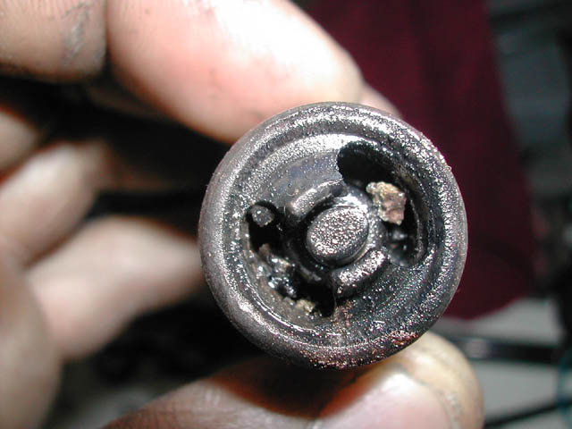
FUEL
SPARK PLUG
CARBON DEPOSIT

Slide 61
FUEL
VAPOUR LOCK
EXCESSIVELY HIGH TEMPERATURES CAN CAUSE FUEL TO VAPORIZE AND BLOCK THE FLOW OF LIQUID FUEL TO THE ENGINE.
ACTIVATE FUEL PUMP TO INCREASE THE PRESSURE FLOW OF COOLER LIQUID FUEL TO THE ENGINE.

Slide 62
FUEL
VAPOUR LOCK
MOGAS IS PRONE TO VAPOUR LOCKING AT TEMPERATURES ABOVE 24° C AND AT ALTITUDES ABOVE 6,000’.
ADDITIONALLY MOGAS IS MORE SUSCEPTIBLE TO CARBURETOR ICING.

Slide 63
FUEL
DETONATION
ABNORMALLY RAPID COMBUSTION OF FUEL.
CAUSED BY LOW OCTANE FUEL / ENGINE OVERHEATING / TOO LEAN A MIXTURE.
PRE-IGNITION
PREMATURE IGNITION OF FUEL MIXTURE.
GLOWING CARBON PARTICLES, “HOT SPOTS”.

Slide 64
FUEL SYSTEM
GRAVITY FEED SYSTEM
FUEL TANKS MOUNTED ABOVE CARBURETOR.
HIGH WING, LOWER PERFORMANCE AIRCRAFT.

Slide 65
FUEL SYSTEM
FUEL PUMP SYSTEM
AN ENGINE DRIVEN FUEL PUMP SUPPLIES PRESSURE TO SUPPLY FUEL TO THE ENGINE.
LOW WING & HIGHER PERFORMANCE AIRCRAFT.

Slide 66
FUEL SYSTEM
FUEL TANKS
AIRCRAFT FUEL TANKS ARE TYPICALLY LOCATED IN THE WINGS.
THEY ARE CONSTRUCTED OF MATERIALS THAT WILL NOT CHEMICALLY REACT WITH FUEL.

Slide 67
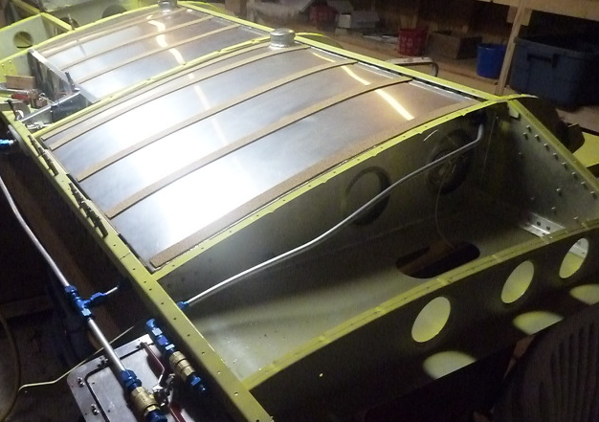
FUEL SYSTEMS
FUEL TANK

Slide 68
FUEL SYSTEM
FUEL TANKS
TANKS CAN BE CONSTRUCTED WITH ALUMINUM ALLOY, OR CAN BE SYNTHETIC RUBBER / NYLON BLADDERS.
AREAS INSIDE AIRCRAFT WINGS THAT HAVE BEEN SEALED TO ALLOW FOR FUEL STORAGE ARE KNOWN AS INTEGRAL TANKS, OR “WET WINGS”.

Slide 69
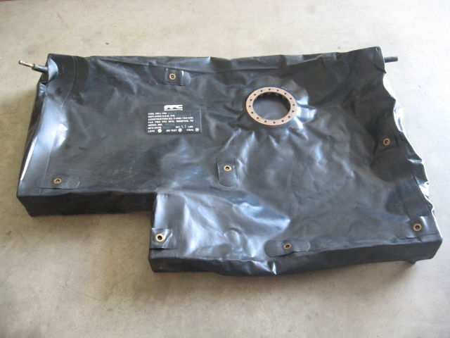
FUEL SYSTEMS
FUEL BLADDER

Slide 70
FUEL SYSTEM
FUEL PRIMER
A HAND OR ELECTRIC PUMP USED TO ASSIST WITH STARTING THE ENGINE.
FUEL IS DELIVERED DIRECTLY INTO THE CYLINDERS OR INTO THE INTAKE MANIFOLD DEPENDING UPON THE TYPE OF ENGINE.

Slide 71
FUEL SYSTEM
FUEL LINES
COMPONENTS OF THE FUEL SYSTEM ARE CONNECTED WITH SOLID ALUMINUM, FLEXIBLE SYNTHETIC RUBBER, OR BRAIDED FUEL LINES.
STRAINERS AND SUMPS ARE POSITIONED IN THE FUEL SYSTEM IN ORDER TO PURGE CONTAMINANTS FROM THE SYSTEM.

Slide 72
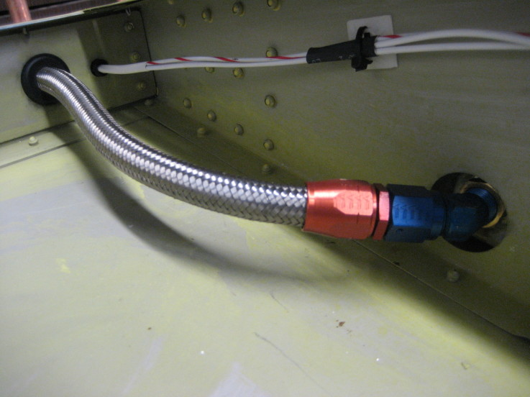
FUEL SYSTEMS
BRAIDED ALUMINUM
FUEL LINE

Slide 73
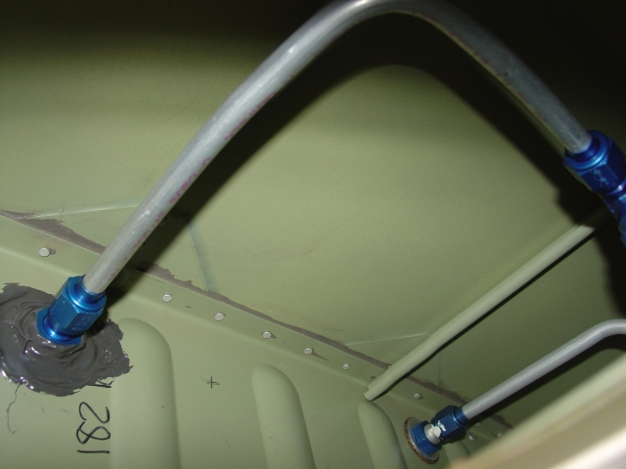
FUEL SYSTEMS
SOLID ALUMINUM
FUEL LINE

Slide 74
FUEL SYSTEM
FUEL VENTING
FUEL SYSTEMS MUST BE VENTED, ALLOWING AIR INTO EACH TANK TO TAKE THE PLACE OF CONSUMED FUEL, AND TO ALLOW FOR FUEL EXPANSION WHEN WARMED.
VENTING CAN BE ACCOMPLISHED BY PRESSURE VENTING, OR BY THE USE OF VENTED FUEL CAPS.

Slide 75
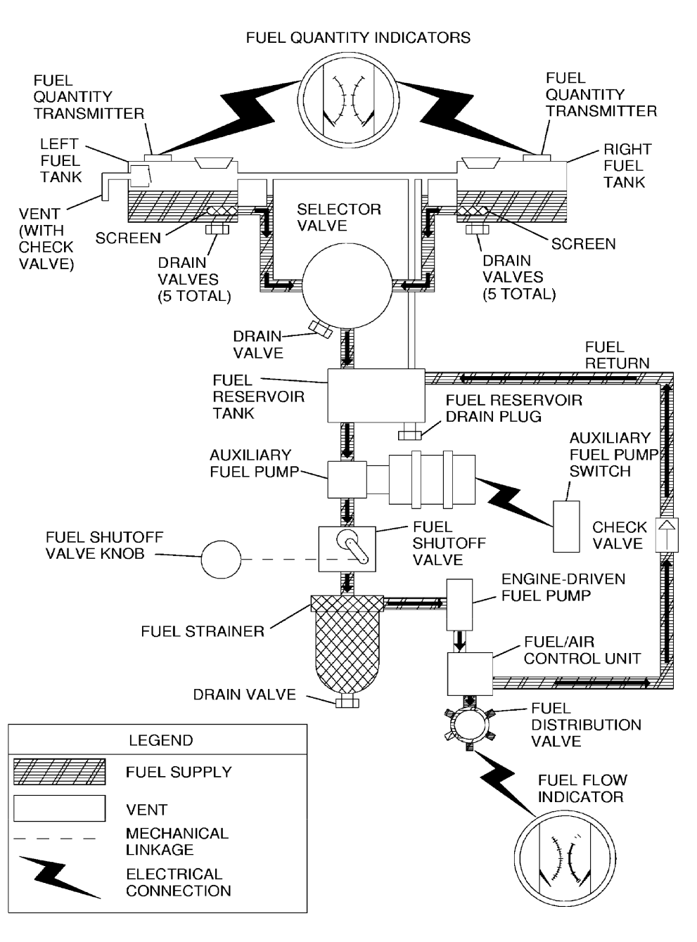
FUEL SYSTEMS
POH 7-27

Slide 76
FUEL SYSTEM
FUEL MANAGEMENT
ENGINE FUEL CONSUMPTION MUST BE MONITORED BY THE PILOT THROUGH POWER SETTING, MIXTURE CONTROL, AND BY FUEL TANK SELECTION (VALVING).
LARGER AND MORE COMPLEX AIRCRAFT MAY HAVE MULTIPLE FUEL TANKS REQUIRING THE TRANSFERAL OF FUEL THROUGHOUT THE FLIGHT.

Slide 77
PITOT STATIC SYSTEM
PITOT TUBE
A SOURCE USED TO MEASURE THE RAM AIR PRESSURE (DYNAMIC PRESSURE CREATED BY THE AIRCRAFT IN MOTION).
THE PITOT IS NORMALLY LOCATED ON THE WING, FACING FORWARD AND IS EXPOSED TO THE RELATIVE AIRFLOW.
THE PITOT IS CONNECTED TO THE AIRSPEED INDICATOR THROUGH THE PITOT STATIC SYSTEM.

Slide 78
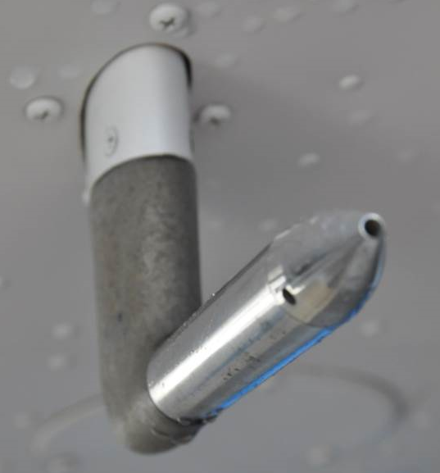
PITOT STATIC SYSTEM
PITOT TUBE

Slide 79
PITOT STATIC SYSTEM
STATIC PORT
A SOURCE USED TO MEASURE THE AMBIENT PRESSURE OUTSIDE THE AIRCRAFT.
THE STATIC SOURCE IS NORMALLY LOCATED ON THE SIDE OF THE AIRCRAFT.
THE STATIC PORT IS CONNECTED TO THE AIRSPEED INDICATOR, ALTIMETER, AND VERTICAL SPEED INDICATOR.

Slide 80
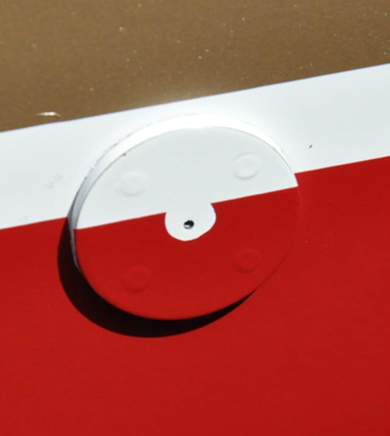
PITOT STATIC SYSTEM
STATIC PORT

Slide 81
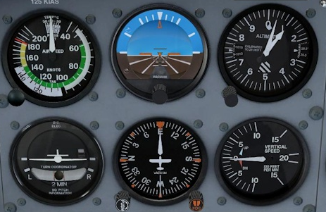
PITOT STATIC SYSTEM

Slide 82
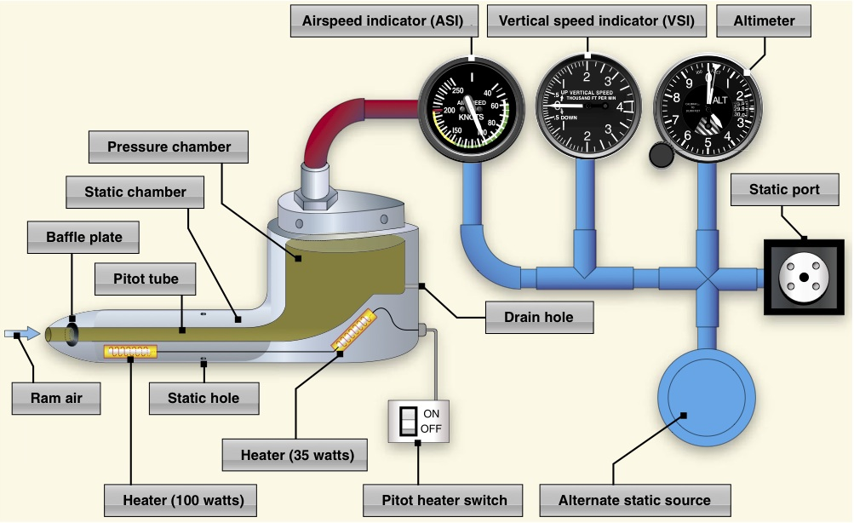
PITOT STATIC SYSTEM

Slide 83
AIRSPEED INDICATOR
CONSTRUCTION
MEASURES THE DIFFERENCE BETWEEN THE PRESSURE IN THE PITOT SYSTEM, AND THE PRESSURE IN THE STATIC SYSTEM.
THE PITOT TUBE ADMITS DYNAMIC AIR INTO AN ANEROID CAPSULE (TOTAL PRESSURE).
A VENT ALLOWS OUTSIDE STATIC PRESSURE TO ENTER THE INSTRUMENT CASE.

Slide 84
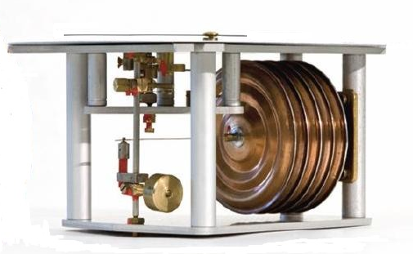
AIRSPEED INDICATOR
ANEROID CAPSULE

Slide 85
AIRSPEED INDICATOR
FUNCTION
SENSES THE PRESSURE FROM THE PITOT TUBE, SUBTRACTS THE PRESSURE FROM THE STATIC SOURCE TO PROVIDE A MEASURE OF THE AIRPLANES FORWARD SPEED
TOTAL PRESSURE – STATIC PRESSURE = DYNAMIC PRESSURE.
THE READING IS DISPLAYED ON A GRADUATED SCALE ON THE FACE OF THE INSTRUMENT.

Slide 86
AIRSPEED INDICATOR
MARKINGS
COLOR CODES INDICATE SAFE OPERATING RANGES AND LIMITS.
RED → NEVER EXCEED SPEED (VNE)
YELLOW → CAUTION RANGE (VNO – VNE)
GREEN → NORMAL RANGE (VS – VNO)
WHITE → FLAP SPEED RANGE (VSO – VFE)

Slide 87
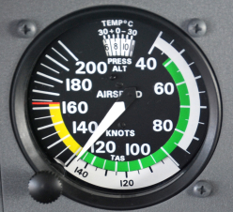
AIRSPEED INDICATOR

Slide 88
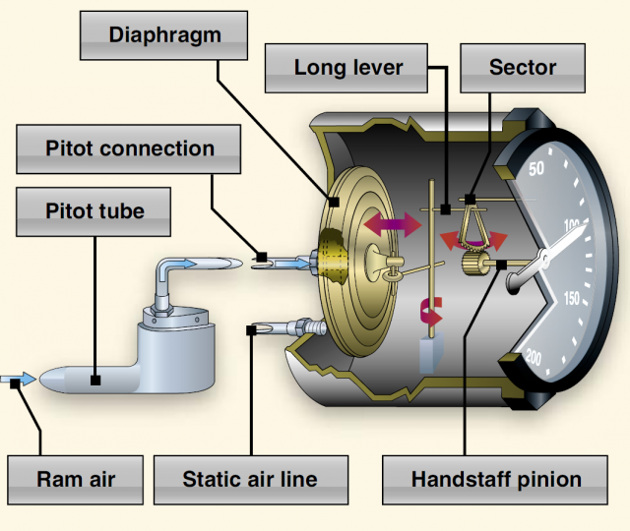
AIRSPEED INDICATOR

Slide 89
AIRSPEED INDICATOR
DEFINITIONS
INDICATED AIRSPEED (IAS):
AIRSPEED READ FROM THE AIRSPEED INDICATOR
CALIBRATED AIRSPEED (CAS):
AIRSPEED CORRECTED FOR INSTRUMENT POSITION
→ AERODYNAMIC PERFORMANCE
TRUE AIRSPEED (TAS):
CAS CORRECTED FOR TEMPERATURE & PRESSURE
(THE ACTUAL SPEED THROUGH THE AIR MASS)
→ NAVIGATIONAL PERFORMANCE

Slide 90
AIRSPEED INDICATOR
ERRORS
DENSITY:
AIRSPEED INDICATORS ARE CALIBRATED TO SEA LEVEL UNDER THE CONDITIONS OF A STANDARD ATMOSPHERE (29.92”HG / 15°C).
FOR EVERY 1000’ GAIN IN ALTITUDE, IAS WILL DECREASE 2% FROM TAS.
EXAMPLE: 110 IAS AT 5,000’
2% x 5 = 10%
10% x 110 IAS = 11 KTS
= 121 TAS

Slide 91
AIRSPEED INDICATOR
ERRORS
POSITION:
THE POSITION OF THE AIRSPEED INDICATOR AND PLUMBING TO THE PITOT TUBE RESULT IN ERRORS.
CALIBRATION TABLES CAN BE FOUND IN THE POH.
CESSNA POH (PERFORMANCE 5-9)

Slide 92
AIRSPEED INDICATOR
ERRORS
LAG:
MECHANICAL ERROR DUE TO THE FRICTION OF THE MOVEMET OF THE WORKING PARTS OF THE INSTRUMENT.
HYSTERESIS, THE ELASTICITY OF THE ANEROID CAPSULE CONTRUBUTE TO THIS ERROR.

Slide 93
AIRSPEED INDICATOR
BLOCKED PITOT TUBE (ICING)
A BLOCKED PITOT WILL CAUSE THE AIRSPEED INDICATOR TO RESPOND TO CLIMBS AND DESCENTS LIKE AN ALTIMETER.
WITH A GAIN IN ALTITUDE AIRSPEED WILL INCREASE, WITH A DECREASE IN ALTITUDE AIRSPEED WILL DECREASE.
PITOT HEAT CAN BE SELECTED TO MELT THE ICE.

Slide 94
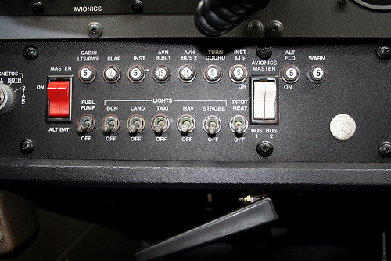
AIRSPEED INDICATOR
PITOT
HEAT

Slide 95
AIRSPEED INDICATOR
BLOCKED STATIC SOURCE
THE AIRSPEED INDICATOR WILL UNDER-READ IN A CLIMB.
THE AIRSPEED INDICATOR WILL OVER-READ IN A DESCENT.

Slide 96
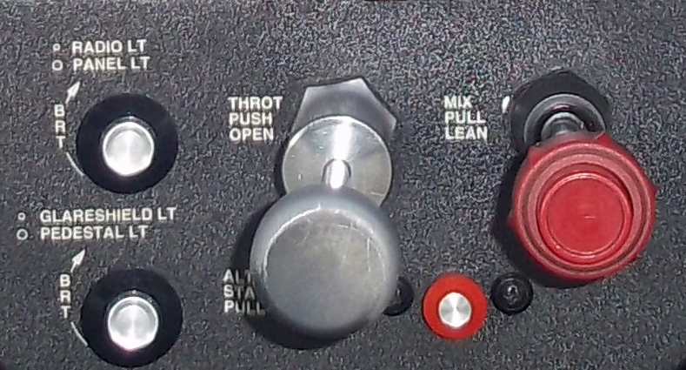
AIRSPEED INDICATOR
ALTERNATE
STATIC

Slide 97
ALTIMETER
CONSTUCTION
AN ANEROID BAROMETER WHICH MEASURES THE PRESSURE OF THE ATMOSPHERE.
THE ATMOSPHERIC PRESSURE AT ANY POINT IS DUE TO THE WEIGHT OF THE OVERLYING AIR ABOVE.
AN OUTLET VENT ALLOWS OUTSIDE STATIC PRESSURE TO ENTER THE CASE AS THE AIRCRAFT CLIMBS AND DESCENDS.

Slide 98
ALTIMETER
FUNCTION
THE SEALED ANEROID CAPSULE IS 99% EVACUATED OF AIR.
AS THE AIRCRAFT CLIMBS OR DESCENDS, THE ANAROID CAPSULE EXPANDS OR CONTRACTS DUE TO THE CHANGE IN STATIC PRESSURE.
EXPANSION AND CONTRACTION TRANSMITS MOTION TO GEARS AND LEVERS ROTATING HANDS ON THE FACE OF THE ALTIMETER.

Slide 99
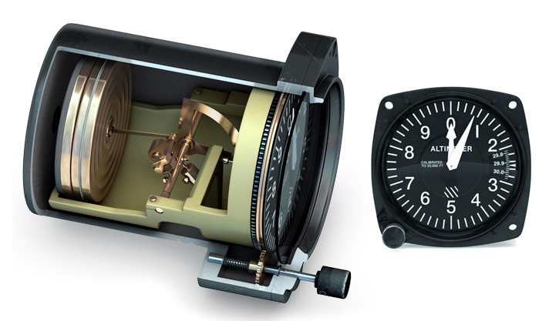
ALTIMETER

Slide 100
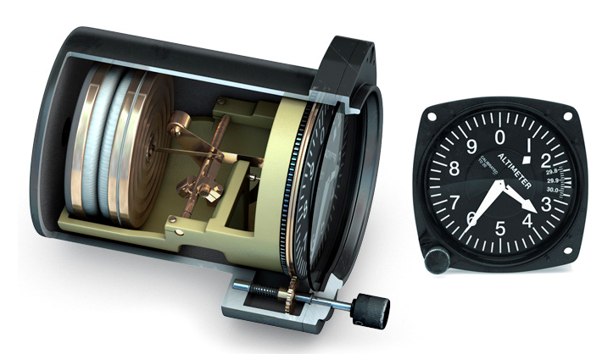
ALTIMETER

Slide 101
ALTIMETER
FUNCTION
FITTED WITH A BAROMETRIC SCALE CALIBRATED IN INCHES OF MERCURY (”HG) OR MILLIBARS (MB).
THE PILOT SETS THE CURRENT ALTIMETER SETTING IN THE COLESMAN WINDOW.
THE ALTIMETER INDICATES THE ALTITUDE ABOVE SEA LEVEL.

Slide 102
ALTIMETER
QNH
IS USED OUTSIDE NORTH AMERICA TO DEFINE: “BAROMETRIC PRESSURE ADJUSTED TO SEA LEVEL”.
“Q” CODES ARE A COLLECTION OF THREE-LETTER MESSAGE ENCODINGS ALSO KNOWN AS A BREVITY CODE.
ORIGINALLY DEVELOPED FOR COMMERCIAL RADIOTELEGRAPH MORSE CODE COMMUNICATION.

Slide 103
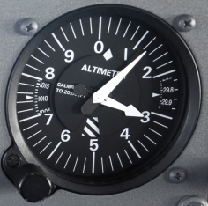
ALTIMETER
MB
”HG

Slide 104
ALTIMETER
FUNCTION
MUST BE SET TO THE ALTIMETER SETTING OF THE CLOSEST ALTIMETER SETTING SOURCE.
INDICATES “TRUE ALTITUDE” UNDER THE CONDITIONS OF A STANDARD ATMOSPHERE 29.92”HG 15°C AT SEA LEVEL.

Slide 105
ALTIMETER
DEFINITIONS
INDICATED ALTITUDE (IALT):
ALTITUDE READ FROM THE ALTIMETER
PRESSURE ALTITUDE (PALT):
THE READING ON THE ALTIMETER WHEN SET TO 29.92”HG (STANDARD PRESSURE)
DENSITY ALTITUDE (DALT):
PRESSURE ALTITUDE CORRECTED FOR TEMPERATURE
→ PERFORMANCE ALTITUDE

Slide 106
ALTIMETER
DEFINITIONS
TRUE ALTITUDE (TALT):
THE EXACT HEIGHT ABOVE MEAN SEA LEVEL
ABSOLUTE ALTITUDE (AALT):
THE ACTUAL HEIGHT ABOVE THE EARTH’S SURFACE

Slide 107
ALTIMETER
ERRORS
AN ALTIMETER THAT IS SET HIGH WILL RESULT IN AN ALTIMETER READING THAT IS HIGH.
AN ALTIMETER THAT IS SET LOW WILL RESULT IN AN ALTIMETER READING THAT IS LOW.
1.0”HG = 1000’
0.1”HG = 100’
0.01”HG = 10’

Slide 108
ALTIMETER
ERRORS
FLYING FROM AN AREA OF HIGHER PRESSURE TO AN AREA OF LOWER PRESSURE.
“FROM HIGH TO LOW, LOOK OUT BELOW!”
30.02”HG / IALT 2,500’ → 29.92”HG = ?
ALTIMETER READS 2,500’
PILOT DESCENDS TO 2,400’

Slide 109
ALTIMETER
BLOCKED STATIC SOURCE
FULL BLOCKAGE:
WILL “FREEZE” AND NOT RESPOND TO CLIMBS AND DESCENTS.
PARTIAL BLOCKAGE:
WILL UNDER-READ IN A CLIMB AND WILL OVER- READ IN A DESCENT, AND THEN CATCH UP WHEN LEVEL.
TO RECTIFY A BLOCKAGE AN ALTERNATE STATIC VALVE CAN BE OPENED INSIDE THE COCKPIT.

Slide 110
ALTIMETER
ALTERNATE
STATIC

Slide 111
VERTICAL SPEED INDICATOR
CONSTRUCTION
AN OUTLET VENT CONNECTS THE STATIC SOURCE DIRECTLY TO THE ANEROID CAPSULE.
A CAPILLARY TUBE ALLOWS AIR TO METER VERY SLOWLY INTO THE INSTRUMENT CASE.
A QUICK CHANGE IN PRESSURE INSIDE THE ANEROID CAPSULE IS COMPARED TO THE SLOW CHANGE IN PRESSURE WITHIN THE INSTRUMENT CASE.

Slide 112
VERTICAL SPEED INDICATOR
FUNCTION
INFORMATION IS TRANSMITTED BY A LINKAGE TO A DIAL ON THE INSTRUMENT.
WITH A DECREASE IN ALTITUDE THE ANEROID EXPANDS, RESULTING IN A NEGATIVE VERTICAL SPEED.
WITH A GAIN IN ALTITUDE THE ANEROID COLAPSES, RESULTING IN A POSITIVE VERTICAL SPEED.

Slide 113
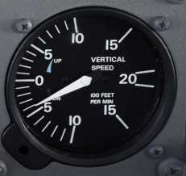
VERTICAL SPEED INDICATOR

Slide 114
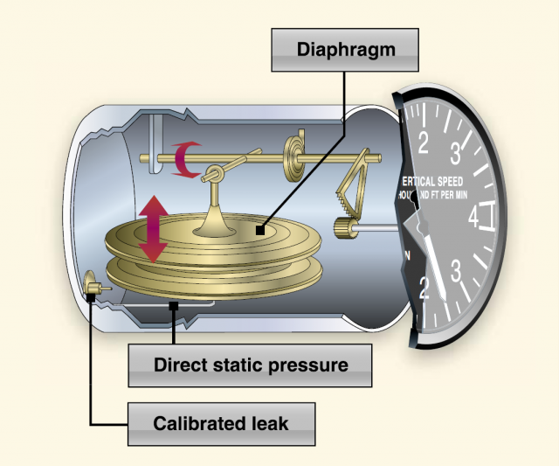
VERTICAL SPEED INDICATOR

Slide 115
VERTICAL SPEED INDICATOR
ERRORS
LAG
A CHANGE IN ALTITUDE MUST OCCUR BEFORE THE VSI WILL REGISTER A CHANGE.
THERE CAN BE A 6 – 9 SECOND LAG ASSOCIATED WITH THE VSI.

Slide 116
GYRO INSTRUMENTS
GYROSCOPE
A ROTOR, OR SPINNING WHEEL ROTATING AT HIGH SPEED IN A GIMBALED MOUNTING.
ITS AXLE CAN BE POINTED IN ANY DIRECTION.
TURN COODINATOR, ATTITUDE INDICATOR AND HEADING INDICATOR INCORPORATE GYROS.

Slide 117
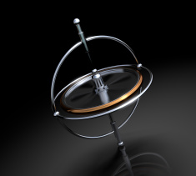
GYRO INSTRUMENTS

Slide 118
GYRO INSTRUMENTS
GYROSCOPE
PLANE OF ROTATION
SPIN AXIS
INNER GIMBAL
OUTER GIMBAL

Slide 119
GYRO INSTRUMENTS

Slide 120
GYRO INSTRUMENTS
GYROSCOPIC INERTIA
“RIGIDITY IN SPACE” IS THE TENDANCY OF A ROTATING BODY IF UNDISTURBED TO MAINTAIN ITS PLANE OF ROTATION.

Slide 121
GYRO INSTRUMENTS
PRECESSION
THE TENDANCY OF A ROTATING BODY, WHEN A FORCE IS APPLIED TO CHANGE ITS PLANE OF ROTATION, THAT THE RESULTANT FORCE ACTS 90° IN THE DIRECTION OF ROTATION.

Slide 122
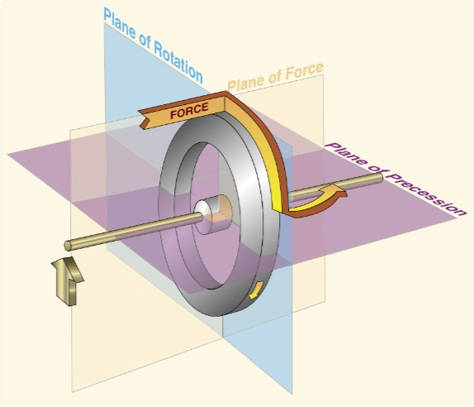
GYRO INSTRUMENTS

Slide 123
GYRO INSTRUMENTS
POWER SOURCES
GYROSCOPIC INSTRUMENTS REQUIRE A POWER SOURCE TO SPIN THE GYROS:
VACUUM SYSTEM – VENTURI TUBE
VACUUM SYSTEM – ENGINE DRIVEN PUMP
ELECTRICAL SYSTEM

Slide 124
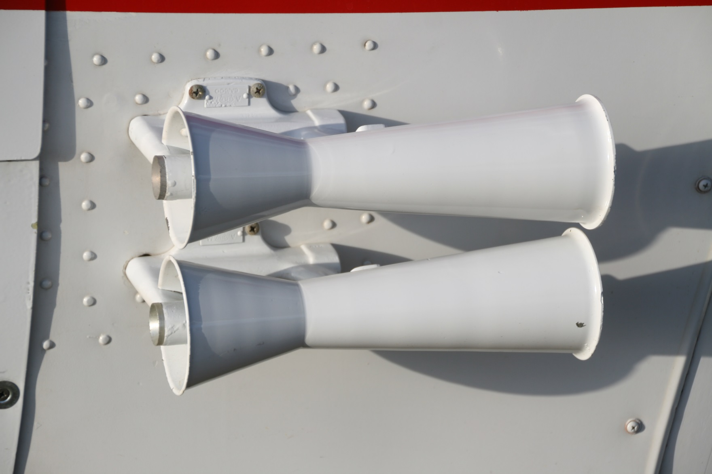
GYRO INSTRUMENTS
VENTURI TUBES

Slide 125
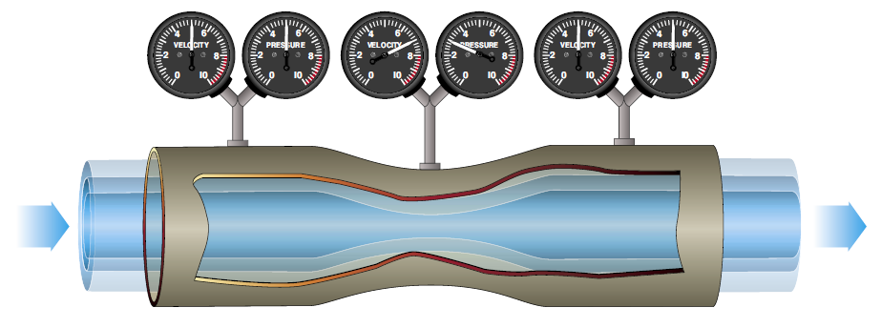
GYRO INSTRUMENTS

Slide 126
GYRO INSTRUMENTS
VENTURI TUBE VACUUM SYSTEM
SIMPLE AND INEXPENSIVE.
EFFICIENCY IS DEPENDANT UPON THE AIRSPEED OF THE AIRCRAFT.
CREATES PARASITIC DRAG.

Slide 127
GYRO INSTRUMENTS
ENGINE DRIVEN VACUUM SYSTEM
OPERATES AS SOON AS THE ENGINE STARTS.
EFFICIENCY IS DEPENDANT UPON ENGINE RPM.
LOW RPM = LOW TO NO VACUUM
ENGINE FAILURE = NO VACUUM

Slide 128
GYRO INSTRUMENTS
ENGINE DRIVEN VACUUM SYSTEM
VACUUM GAUGE SHOWS RELATIVE DIFFERENCE BETWEEN OUTSIDE AIR PRESSURE AND VACUUM PRESSURE IN THE SYSTEM.
OPERATES AT 4 – 6” HG.
TOO HIGH A VACUUM CAUSES EXCESSIVE WEAR OF THE GYRO BEARINGS.

Slide 129
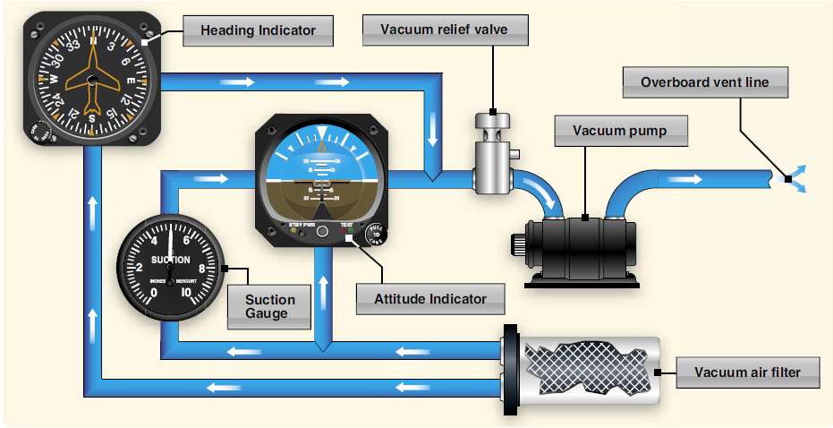
GYRO INSTRUMENTS

Slide 130
VACUUM GYROS

Slide 131

GYRO INSTRUMENTS
VACUUM PUMP

Slide 132
GYRO INSTRUMENTS
ELECTRIC GYROS
USED IN AIRCRAFT FLOWN AT HIGH ALTITUDES WHERE AIR PRESSURE IS TOO LOW TO RUN A VACUUM SYSTEM.
FOR REDUNDANCY IT IS COMMON PRACTICE TO USE A COMBINATION OF ELECTRIC AND VACUUM DRIVEN GYROS IN CASE OF A SYSTEM FAILURE.

Slide 133
ELECTRICAL GYROS

Slide 134

HEADING INDICATOR

Slide 135
HEADING INDICATOR
CONSTRUCTION
THE GYRO WHEEL IS MOUNTED VERTICALLY AND SPINS ABOUT A HORIZONTAL AXIS AT APPROXIMATELY 12,000 RPM – DIRECTIONAL GYRO.
IT OBEYS THE GYROSCOPIC PRINCIPAL OF RIGIDITY IN SPACE.

Slide 136

HEADING INDICATOR

Slide 137
HEADING INDICATOR
FUNCTION
THE GYRO IS MOUNTED IN AN INNER GIMBAL RING ROTATING FREELY ABOUT THE HORIZONTAL AXIS.
THE INNER GIMBAL RING IS MOUNTED IN AN OUTER GIMBAL RING WHICH IS GEARED TO THE COMPASS CARD.

Slide 138
HEADING INDICATOR
LIMITATIONS
THE GYRO IS NOT NORTH SEEKING AND MUST BE SYNCHRONIZED TO THE MAGNETIC COMPASS.
“PRECESSION ERROR” IS CAUSED BY GYRO FRICTION RESULTING IN A 3° ERROR EVERY 15 MINUTES.

Slide 139
HEADING INDICATOR
LIMITATIONS
“APPARENT PRECESSION”, DUE TO THE ROTATION OF THE EARTH, (VARIED BY LATITUDE) CAN CREATE 15° ERRORS PER HOUR AT THE POLES AND ZERO ERROR AT THE EQUATOR.
HEADING INDICATORS CAN REMAIN FUNCTIONAL IN BANKS, CLIMBS, AND DESCENTS OF UP TO 85°.

Slide 140


Slide 141


Slide 142


Slide 143


Slide 144

HEADING INDICATOR
APPARENT PRECESSION = 15 sin latitude deg / hour

Slide 145

ATTITUDE INDICATOR

Slide 146
ATTITUDE INDICATOR
CONSTRUCTION
THE GYRO WHEEL IS MOUNTED HORIZONTALLY AND SPINS ABOUT A VERTICAL AXIS – VERTICAL GYRO.
GYRO SPEED IS APPROXIMATELY 10,000 – 18,000 RPM, DEPENDING UPON MANUFACTURER.
IT OBEYS THE GYROSCOPIC PRINCIPAL OF RIGIDITY IN SPACE.

Slide 147
ATTITUDE INDICATOR
FUNCTION
THE GYRO IS MOUNTED IN A UNIVERSAL GIMBAL RING SYSTEM ALLOWING THE ROTOR TO ALWAYS SPIN HORIZONTAL TO THE HORIZON.
THE HORIZON BAR IS ATTATCHED BY A PIVOT ARM TO THE GIMBAL RING.

Slide 148

GYRO INSTRUMENTS

Slide 149
ATTITUDE INDICATOR
MARKINGS
PITCH MARKINGS EVERY 10°
BANK MARKING AT 10° - 20° - 30° - 60° - 90°

Slide 150
ATTITUDE INDICATOR
10°
20°
45°
30°
60°
20°
10°
90°

Slide 151
ATTITUDE INDICATOR
LIMITATIONS
VACUUM DRIVEN INSTRUMENTS HAVE PITCH LIMITS OF UP TO 60°, AND ROLL LIMITS OF UP TO 110°.
WHEN THESE LIMITS ARE EXCEEDED THE GYRO WILL TUMBLE CAUSING EXCESSIVE GYRO BEARING WEAR.
THE ROTOR WILL PRECESS BACK TO THE HORIZONTAL PLANE AT APPROXIMATELY 8° PER MINUTE.

Slide 152


Slide 153
ATTITUDE INDICATOR
LIMITATIONS
PRECESSION ERRORS CAUSE A “PITCH UP” INDICATION WITH AN ACCELERATION, AND A “PITCH DOWN” INDICATION WITH A DECELERATION.
DURING A SKIDDING TURN, THE GYRO PRECESSES TO THE INSIDE OF THE TURN. AFTER THE SKID, A BANK INDICATION TOWARDS THE SKID DIRECTION.

Slide 154

TURN & BANK

Slide 155
TURN & BANK
CONSTRUCTION
THE GYRO WHEEL IS MOUNTED VERTICALLY AND SPINS ABOUT A HORIZONTAL AXIS.
GYRO SPEED IS APPROXIMATELY 8,000 RPM.
IT OBEYS THE PRINCIPAL OF GYROSCOPIC PRECESSION.

Slide 156
TURN & BANK
FUNCTION
THE GYRO WHEEL IS MOUNTED IN A GIMBAL RING CONNECTED TO THE TURN NEEDLE ON THE FACE OF THE INSTRUMENT.
THE BALL MOVES INDEPENDENTLY OF THE GYRO GIMBAL, RESPONDING TO GRAVITY AND CENTRIFUGAL FORCE.

Slide 157

TURN AND BANK

Slide 158
TURN & BANK
FUNCTION
WHEN THE AIRCRAFT TURNS LEFT OR RIGHT, THE GYRO PRECESSES ROLLING THE GIMBLE RING.
THE TURN INDICATOR INDICATES THE RATE OF TURN (3° PER SECOND).
THE BALL INDICATES COORDINATION / SLIP / SKID.

Slide 159

TURN COORDINATOR

Slide 160
TURN COORDINATOR
CONSTRUCTION
THE GYRO WHEEL IS MOUNTED VERTICALLY AND SPINS ABOUT AN AXIS CANTED 35° TO THE HORIZONTAL.
GYRO SPEED IS APPROXIMATELY 8,000 RPM.
IT OBEYS THE PRINCIPAL OF GYROSCOPIC PRECESSION.

Slide 161
TURN COORDINATOR
FUNCTION
THE GYRO WHEEL IS MOUNTED IN A GIMBAL RING CONNECTED TO THE MINIATURE AIRPLANE ON THE FACE OF THE INSTRUMENT.
THE BALL MOVES INDEPENDENTLY OF THE GYRO GIMBAL, RESPONDING TO GRAVITY AND CENTRIFUGAL FORCE.

Slide 162

TURN COORDINATOR

Slide 163
TURN COORDINATOR
FUNCTION
THE WINGS FIRST REACT TO ROLL AND THEN YAW.
THE TURN INDICATOR INDICATES THE RATE OF ROLL AS WELL AS THE RATE OF TURN (3° PER SECOND).
THE BALL INDICATES COORDINATION / SLIP / SKID.

Slide 164

MAGNETIC COMPASS

Slide 165
MAGNETIC COMPASS
CONSTRUCTION
CONSISTS OF TWO NORTH SEEKING MAGNETS ATTATCHED TO A FLOATING COMPASS CARD.
PIVOTS FREELY WITHIN A COMPASS BOWL FILLED WITH PURIFIED KEROSENE.
THE COMPASS CARD IS GRADUATED IN 5° DIVISIONS, THE HEADING IS INDICATED BY THE LUBBER LINE.

Slide 166
MAGNETIC COMPASS
LIMITATIONS
“DEVIATION” IS THE ERROR BETWEEN MAGNETIC NORTH AND COMPASS NORTH.
IT IS CAUSED BY METALIC INTERFERENCE OF THE AIRFRAME AND ENGINE.
A COMPASS CORRECTION CARD IS PROVIDED TO PROVIDE CORRECTION FOR DEVIATION.

Slide 167

MAGNETIC COMPASS
COMPASS CORRECTION CARD

Slide 168
MAGNETIC COMPASS
LIMITATIONS
THE COMPASS LAGS (UNDER TURNS) WHEN TURNING FROM NORTHERLY HEADINGS.
THE COMPASS LEADS (OVER TURNS) WHEN TURNING FROM SOUTHERLY HEADINGS.
CAUSED BY THE INABILITY OF THE COMPASS MAGNETS TO COMPENSATE FOR THE VERTICAL COMPONENT OF THE EARTH’S MAGNETIC FIELD.

Slide 169

MAGNETIC DIP

Slide 170



ACCELERATION ERROR

Slide 171

DECELERATION ERROR

Slide 172


NORTH TURNING ERROR

Slide 173


SOUTH TURNING ERROR
LATITUDE MATTERS FOR MAGNETIC DIP ERRORS
LATITUDE OF MAXIMUM AND MINIMUM ERRORS?

Slide 174
MAGNETIC COMPASS

Slide 175
MAGNETIC COMPASS
LIMITATIONS
THE COMPASS ROTATES TO THE NORTH WHEN ACCELERATING ON EASTERLY AND WESTERLY HEADINGS.
THE COMPASS ROTATES TO THE SOUTH WHEN DECELERATING ON EASTERLY AND WESTERLY HEADINGS.
CAUSED BY THE PENDULOUS EFFECT OF THE PIVOT POINT MOUNT.

Slide 176
MAGNETIC COMPASS
NORTHERN HEMISPHERE
NORTH
AN
LAG
DS
WEST
EAST
LEAD
SOUTH

Slide 177
MAGNETIC COMPASS
SOUTHERN HEMISPHERE
NORTH
SA
ON
ND
WEST
EAST
US
SOUTH

Slide 178
INSTRUMENT CLASSIFICATION
CONTROL INSTRUMENTS
PROVIDE INSTANTANEOUS INFORMATION WITH RESPECT TO THE CONTROL OF THE AIRCRAFT.
NOSE UP / NOSE DOWN / BANKED.
HIGH POWER / LOW POWER.

Slide 179

CONTROL INSTRUMENTS

Slide 180
INSTRUMENT CLASSIFICATION
PERFORMANCE INSTRUMENTS
PROVIDE TRENDING INFORMATION WITH RESPECT TO THE PERFORMANCE OF THE AIRCRAFT.
SLOW / FAST / CLIMB / DESCEND.
TURNING LEFT / TURNING RIGHT / COORDINATED.

Slide 181
PERFORMANCE INSTRUMENTS

Slide 182
INSTRUMENT CLASSIFICATION
NAVIGATION INSTRUMENTS
PROVIDE VISUAL NAVIGATIONAL INFORMATION.
VERY HIGH FREQUENCY OMNI-DIRECTIONAL RANGE (VOR) / AUTOMATIC DIRECTION FINDER (ADF).
INSTRUMENT LANDING SYSTEM (ILS) / GLOBAL POSITIONING SYSTEM (GPS).

Slide 183
NAVIGATION INSTRUMENTS

Slide 184
RADIAL SCAN

Slide 185
SELECTIVE RADIAL SCAN
INVERTED “L” SCAN

Slide 186
SELECTIVE RADIAL SCAN
“T” SCAN

Slide 187
PARTIAL PANEL SCAN

Slide 188
ZORO SCAN
WRONG!

Slide 189
STAR OF DAVID SCAN
WRONG!

